Slide 1
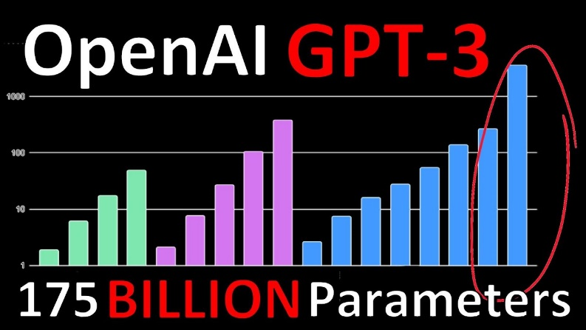
Generative Pre-trained Transformer 3
(GPT-3)
Presenter:
Abduraimjonov Abdurakhmon

Slide 2
Plan
Introduction
How to Use GPT-3
Examples
Grew Creative Lab
Grew Creative Lab
Abduraimjonov Abdurakhmon

Slide 3
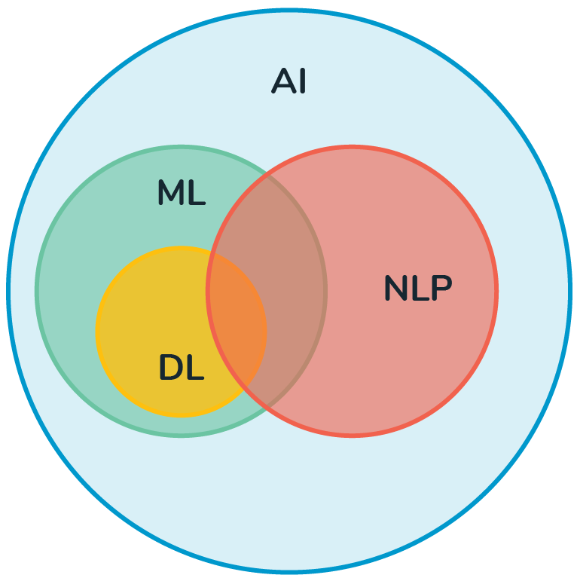
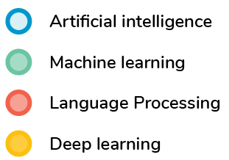
Introduction (1/6)
NLP brief explanation
What is NLP (Natural Language Processing)?
It’s the branch of AI that enables computers to understand, interpret, and manipulate human language.
Grew Creative Lab
Grew Creative Lab
Abduraimjonov Abdurakhmon

Slide 4
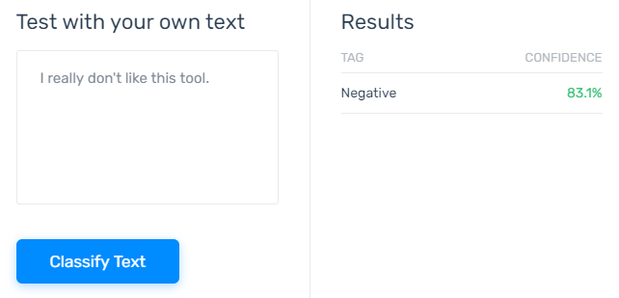
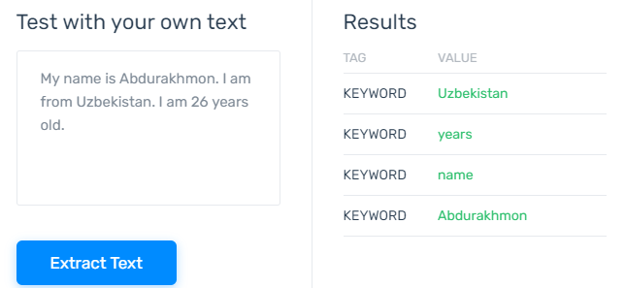
Introduction (2/6)
NLP brief explanation
Some Use Cases of NLP in our life:
1) Sentiment Analysis > identifies emotions in text (e.g. positive, negative and etc)
2) Language Translation > Translating from one language to another (e.g. English < > Korean)
3) Text extraction > pull out pre-defined information from text (e.g. colors, location or key text)
4) Chatbots > AI systems designed to interact with humans through text or speech.
monkeylearn.com
Grew Creative Lab
Grew Creative Lab
Abduraimjonov Abdurakhmon

Slide 5
Introduction (3/6)
NLP models
Pre-trained Models of NLP:
BERT-LARGE
XLNET-LARGE
RoBERTa-LARGE
GPT-2
T5
Turing-NLG
GPT-3
340 million parameters
340 million parameters
355 million parameters
1.5 billion parameters
11 billion parameters
17 billion parameters
175 billion
parameters
Grew Creative Lab
Grew Creative Lab
Abduraimjonov Abdurakhmon

Slide 6
Introduction (4/6)
GPT-3 model brief explanation
What is GPT-3?
GPT-3 is an autoregressive language model that uses deep learning to produce human-like text.
OpenAI's third-generation Generative Pre-trained Transformer, GPT-3, is a general-purpose language algorithm that uses machine learning to translate text, answer questions, and write text predictively
It is the largest language model ever created till date and has been trained on an estimated 45 terabytes of text data, run through 175 billion parameters!
Note: The model is in the private beta version, but the API is available upon request.
Grew Creative Lab
Grew Creative Lab
Abduraimjonov Abdurakhmon

Slide 7
Introduction (5/6)
Used datasets for GPT-3
Datasets used to train GPT-3
Dataset | Quantity (tokens)
Common Crawl (filtered) | 410 billion
WebText2 | 19 billion
Books1 | 12 billion
Books2 | 55 billion
Wikipedia | 3 billion
Grew Creative Lab
Grew Creative Lab
Abduraimjonov Abdurakhmon

Slide 8
Introduction (6/6)
Opportunities of GPT-3
You can ask GPT-3 to be:
a translator,
a blogger,
a programmer,
a poet, or a famous author,
and it can do it with its user (you) providing fewer than 10 training examples.
Grew Creative Lab
Grew Creative Lab
Abduraimjonov Abdurakhmon

Slide 9
How to use GPT-3 (1/7)
Steps for how to work with GPT-3:
1. Get API token from OpenAI
https://forms.office.com/Pages/ResponsePage.aspx?id=VsqMpNrmTkioFJyEllK8s0v5E5gdyQhOuZCXNuMR8i1UQjFWVTVUVEpGNkg3U1FNRDVVRFg3U0w4Vi4u
Link for getting API
https://www.youtube.com/watch?v=7_c3zjpDvqg
Watch video, to
understand how to get API
The model is in the private beta version.
You have to get the secret key (openai.cfg) from https://beta.openai.com/
Set your environment variable to read the secret key:
run export OPENAI_CONFIG=/path/to/config/openai.cfg (for MacOS, Unix, or Linux users) or
set OPENAI_CONFIG=/path/to/config/openai.cfg (for Windows users)
Grew Creative Lab
Grew Creative Lab
Abduraimjonov Abdurakhmon

Slide 10
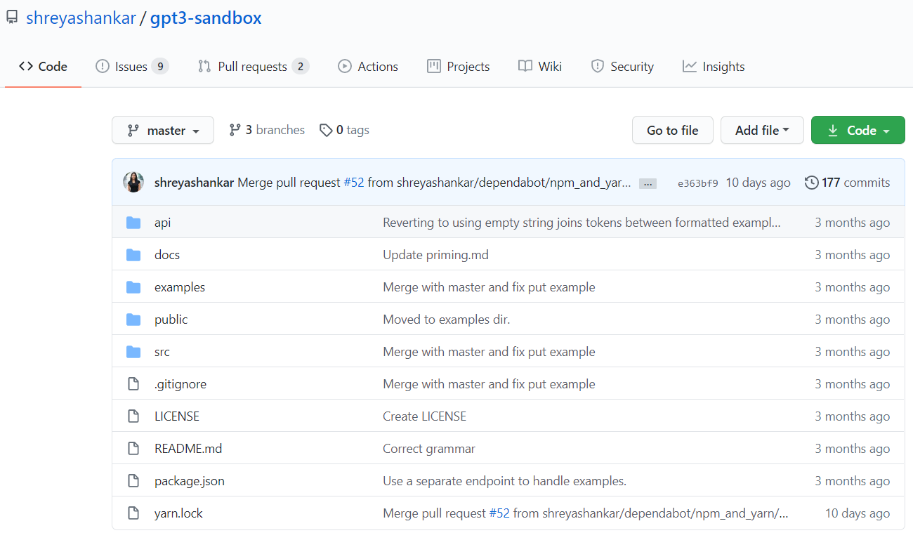
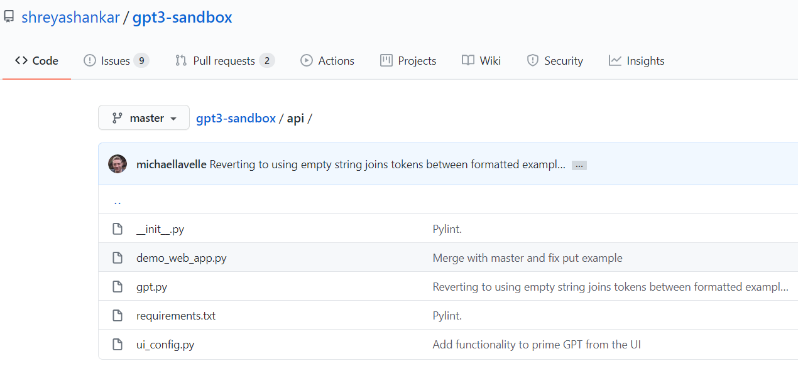
How to use GPT-3 (2/7)
Steps for how to work with GPT-3:
1. Get API token from OpenAI
2. Clone repository
https://github.com/shreyashankar/gpt3-sandbox
provides addition information how to install GPT-3,
Also, it provides clear explanations and some examples
Download the gpt.py
https://github.com/shreyashankar/gpt3-sandbox/tree/master/api
Grew Creative Lab
Grew Creative Lab
Abduraimjonov Abdurakhmon

Slide 11
How to use GPT-3 (3/7)
Steps for how to work with GPT-3:
1. Get API token from OpenAI
2. Clone repository
3. Install OpenAI
pip install openai
Grew Creative Lab
Grew Creative Lab
Abduraimjonov Abdurakhmon

Slide 12
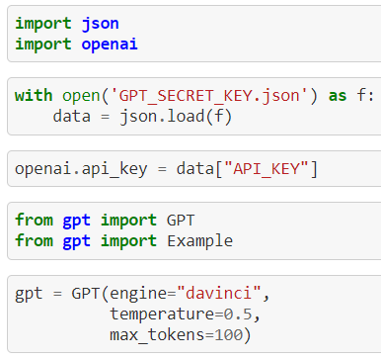
How to use GPT-3 (4/7)
Steps for how to work with GPT-3:
1. Get API token from OpenAI
2. Clone repository
3. Install OpenAI
4. Import modules and setup API token
Grew Creative Lab
Grew Creative Lab
Abduraimjonov Abdurakhmon

Slide 13
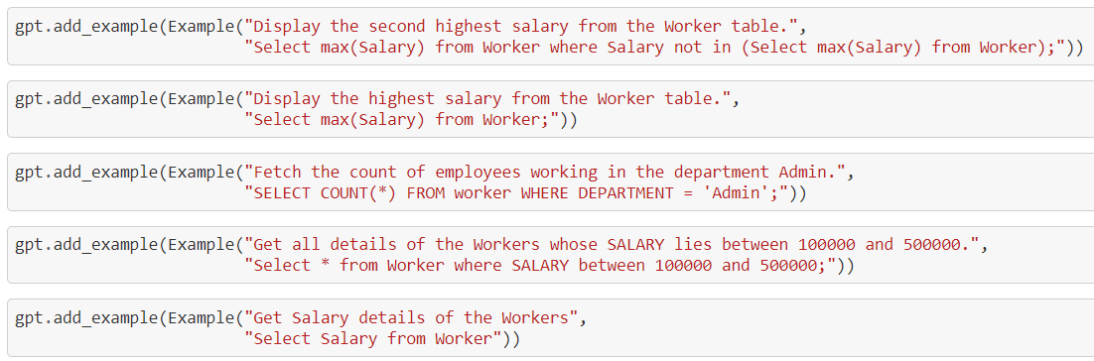
How to use GPT-3 (5/7)
Steps for how to work with GPT-3:
1. Get API token from OpenAI
2. Clone repository
3. Install OpenAI
4. Import modules and setup API token
5. Add examples.
Trying to convert natural language to SQL with the help of very few examples.
Grew Creative Lab
Grew Creative Lab
Abduraimjonov Abdurakhmon

Slide 14
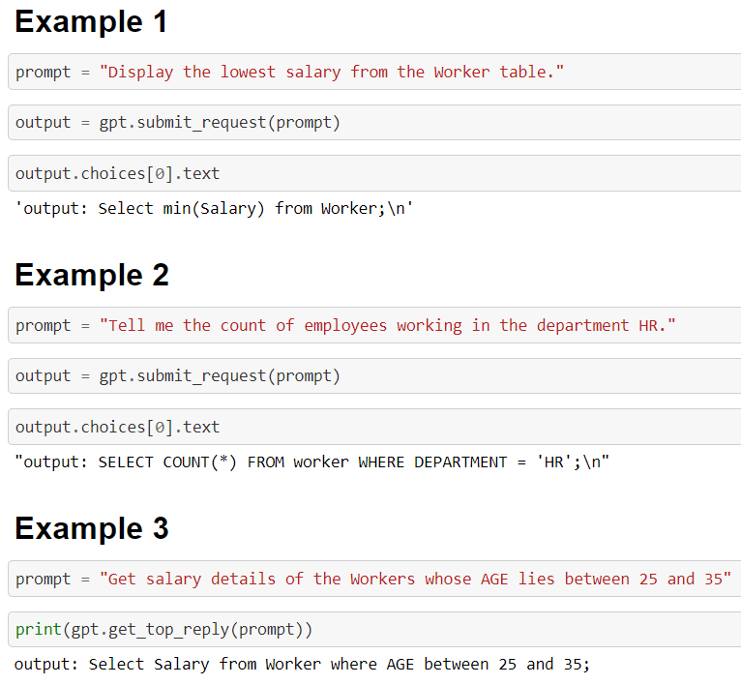
How to use GPT-3 (6/7)
Steps for how to work with GPT-3:
1. Get API token from OpenAI
2. Clone repository
3. Install OpenAI
4. Import modules and setup API token
5. Add examples.
6. Submit input and get output.
Grew Creative Lab
Grew Creative Lab
Abduraimjonov Abdurakhmon

Slide 15
How to use GPT-3 (7/7)
English to LaTeX
from gpt import GPT, Example, set_openai_key
set_openai_key("YOUR_OPENAI_KEY") # omit the Bearer, it should look like "sk-..."
gpt = GPT()
print(gpt.get_top_reply("sum from one to infinity of one over n squared"))
output: n squared over n
gpt.add_example(Example("four y plus three x cubed", "4y + 3x^3" ))
gpt.add_example(Example("integral from a to b", "\\int_a^b"))
print(gpt.get_top_reply("sum from one to infinity of one over n squared"))
output: 1/n^2
Grew Creative Lab
Grew Creative Lab
Abduraimjonov Abdurakhmon

Slide 16
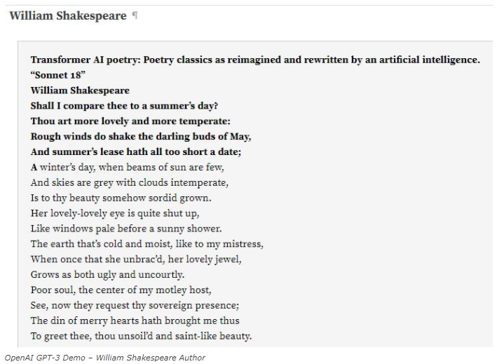
Example (1/6)
GPT-3 becomes an Author
OpenAI GPT-3 has been able to produce poetic text identical to various authors.
For example:
William Shakespeare
Chuang Tzu
William Blake
and so on
Grew Creative Lab
Grew Creative Lab
Abduraimjonov Abdurakhmon

Slide 17
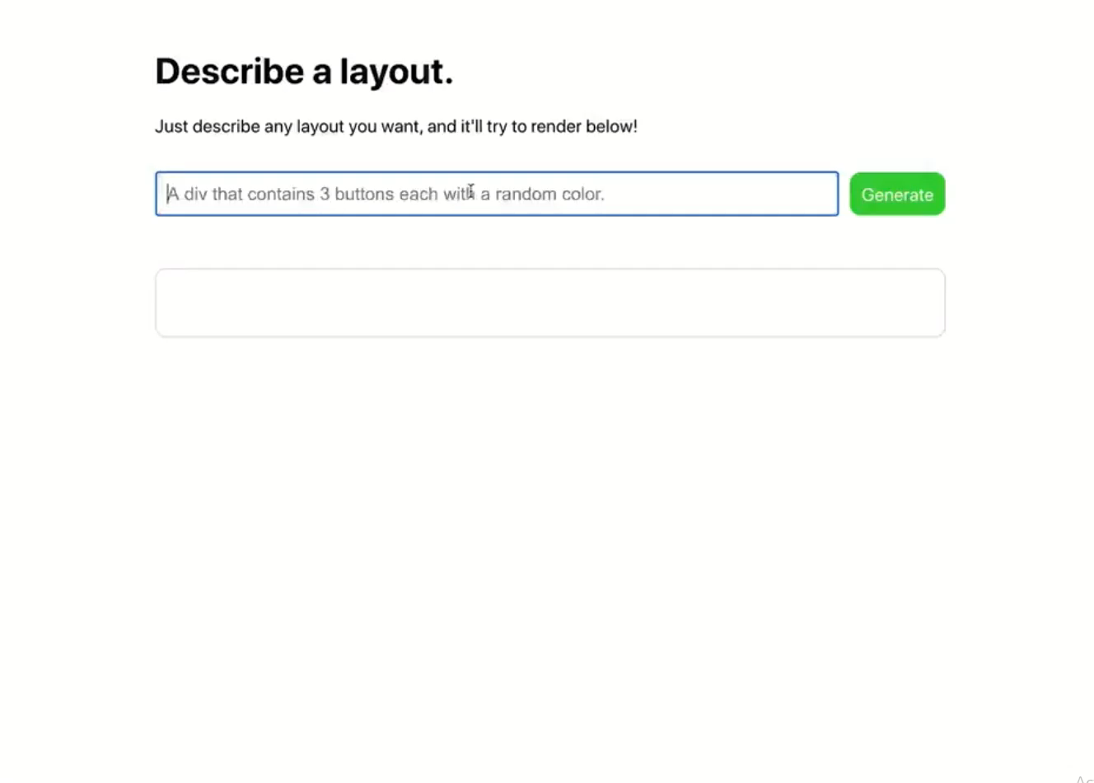
Example (2/6)
can GPT-3 be Software Engineer?
Grew Creative Lab
Grew Creative Lab
Abduraimjonov Abdurakhmon

Slide 18
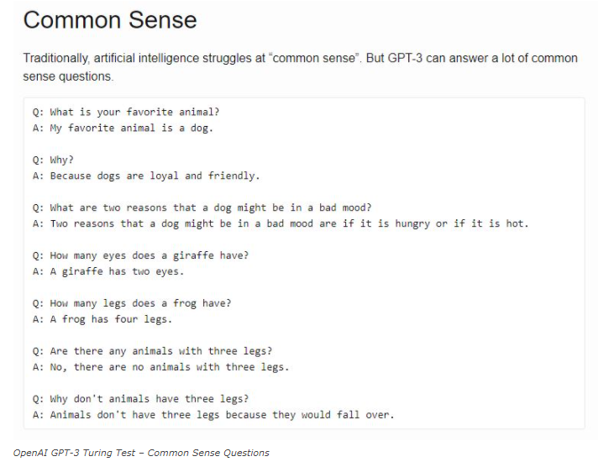
Example (3/6)
Testing GPT-3 with a Turing Test
Grew Creative Lab
Grew Creative Lab
Abduraimjonov Abdurakhmon

Slide 19
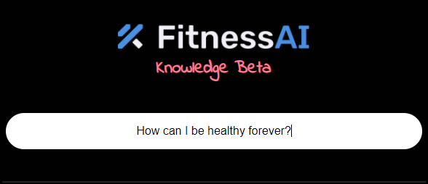
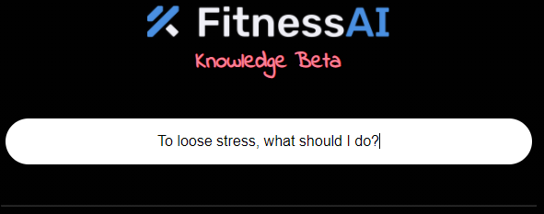
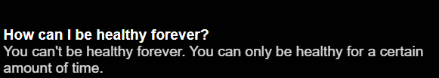
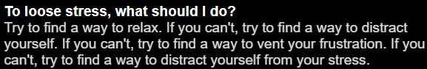
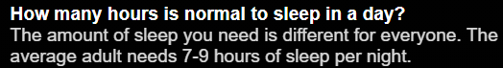
Example (4/6)
FitnessAI uses GPT-3
Grew Creative Lab
Grew Creative Lab
Abduraimjonov Abdurakhmon

Slide 20
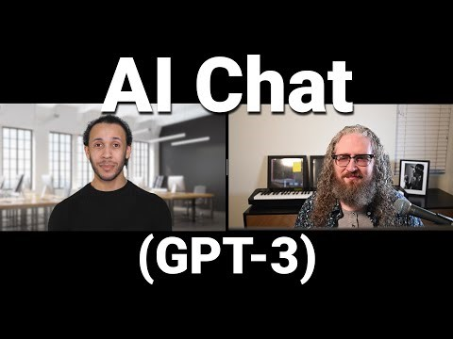
Example (5/6)
GPT-3 may talk like a human
Grew Creative Lab
Grew Creative Lab
Abduraimjonov Abdurakhmon

Slide 21
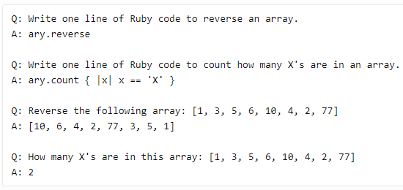
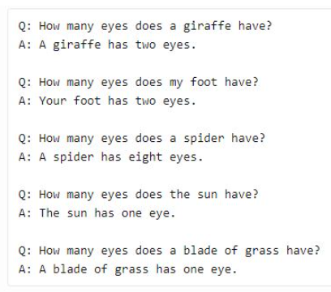
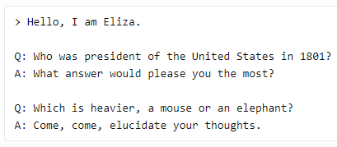
Example (6/6)
GPT-3 Mistakes
Q&A mistakes of GPT-3
Grew Creative Lab
Grew Creative Lab
Abduraimjonov Abdurakhmon

